Slide 1
MODULE 1
Introduction to AI and Society

Slide 2
INTRODUCTION
Intelligence : "The capacity to learn and solve problems.“
Artificial Intelligence (AI): The capability of a machine to imitate intelligent human behavior. This encompasses a range of technologies, including machine learning, natural language processing, robotics, and computer vision, which enable machines to perform tasks that would normally require human intelligence.
Artificial Intelligence : Artificial Intelligence (AI) is the simulation of human intelligence by machines.
1) The ability to solve problems.
2) The ability to act rationally.
3) The ability to act like humans.
The central principles of AI include :
1) Reasoning, knowledge, planning, learning and communication.
2) Perception and the ability to move and manipulate objects.
3) It is the science and engineering of making intelligent machines, especially intelligent computer programs

Slide 3
The development of AI is a multidisciplinary effort that involves computer science, mathematics, neuroscience, psychology, and many other fields. The rapid advancements in AI technologies have the potential to transform numerous industries, enhance productivity, and address complex societal challenges.
Computers with the ability to mimic or duplicate the functions of the human brain.
Artificial Intelligence is the intelligence of machines and the branch of computer science which aims to create it.
"The branch of computer science that is concerned with the automation of intelligent behavior" (Luger and Stubblefield. 1993).

Slide 4
Artificial Intelligence is a branch of Science which deals with helping machines finds solutions to complex problems in a more human-like fashion.
This generally involves borrowing characteristics from human intelligence, and applying them as algorithms in a computer friendly way.
Brief History of A I
1941: First electronic computer (technology finally available)
1956: Term Artificial Intelligence introduced
1960s: Checkers-playing program that was able to play games with opponents
1980s: Quality Control Systems
2000: First sophisticated walking robot

Slide 5
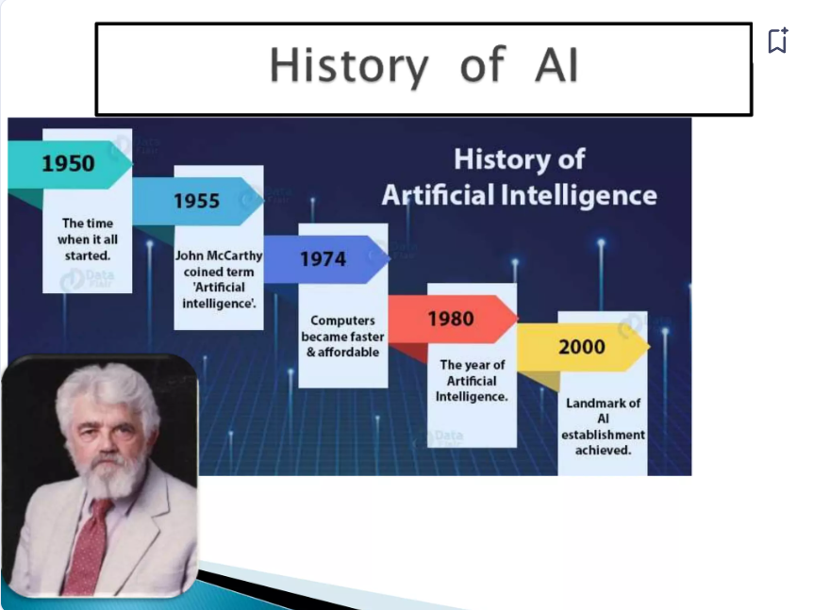

Slide 6
Evolution of AI
The evolution of AI can be traced through several key milestones:
Early Beginnings (1950s-1960s):
Turing Test: Proposed by Alan Turing in 1950, this test assesses a machine's ability to exhibit intelligent behavior indistinguishable from that of a human.
First AI Programs: Early AI research focused on symbolic AI, with programs such as the Logic Theorist and the General Problem Solver.
AI Winters and Resurgences (1970s-1980s):
Periods of reduced funding and interest, known as AI winters, occurred due to unmet expectations and technical challenges. Despite this, significant theoretical work continued, and expert systems were developed for specific applications.
Data-Driven Approaches (1990s-2000s):
Advances in computing power and the availability of large datasets led to the rise of machine learning. Techniques such as support vector machines and decision trees became popular.

Slide 7
The resurgence of neural networks, particularly deep learning, revolutionized AI, enabling significant progress in areas such as image and speech recognition.
4. Modern AI (2010s-Present):
Breakthroughs in deep learning and the development of powerful AI models, such as GPT-3 for natural language processing and AlphaGo for game playing, have demonstrated the potential of AI.
AI is increasingly integrated into various industries, including healthcare, finance, transportation, and entertainment, driving innovation and efficiency.
Artificial Intelligence represents a major technological advancement with the potential to revolutionize numerous aspects of human life. Understanding its definitions, key concepts, and historical evolution provides a foundation for exploring its applications, benefits, and challenges. As AI continues to evolve, it is essential to address ethical and societal implications to ensure that its development and deployment benefit all of humanity.

Slide 8
WHY AI?
Computers are fundamentally well suited to performing mechanical computations, using fixed programmed rules. This allows artificial machines to perform simple monotonous tasks efficiently and reliably, which humans are ill-suited to.
Artificial Intelligence (AI) is important for several reasons, encompassing its transformative impact on various aspects of society, economy, and technology. Here are some key reasons why AI is significant:
Automation and Efficiency:
Labor Automation: AI enables the automation of repetitive and mundane tasks, leading to increased productivity and efficiency in various industries.
Cost Reduction: Automation reduces operational costs and improves overall business efficiency.

Slide 9
Enhanced Decision-Making:
Data Analysis: AI can analyze vast amounts of data quickly and accurately, providing valuable insights that aid in decision-making processes.
Predictive Analytics: AI algorithms can predict trends and outcomes, allowing businesses and governments to make informed decisions.
Personalization:
Consumer Experience: AI enhances user experience by personalizing recommendations, services, and interactions, as seen in platforms like Netflix, Amazon, and Spotify.
Healthcare: AI personalizes medical treatments and care plans based on individual patient data, improving healthcare outcomes.

Slide 10
Innovation and New Capabilities:
Scientific Research: AI accelerates research and development in fields like genomics, drug discovery, and material science.
Creative Industries: AI is used in creative fields such as art, music, and literature, generating new forms of creativity and innovation.
Improved Accessibility:
Assistive Technologies: AI develops technologies that assist individuals with disabilities, such as speech recognition software, predictive text, and automated transcription services.
Education: AI-powered educational tools offer personalized learning experiences, making education more accessible and effective.

Slide 11
Safety and Security:
Cybersecurity: AI enhances cybersecurity measures by identifying and mitigating threats in real-time.
Public Safety: AI is used in surveillance and monitoring systems to improve public safety and emergency response.
Economic Growth:
Job Creation: While AI automates certain jobs, it also creates new job opportunities in AI development, maintenance, and oversight.
Market Expansion: AI drives innovation, leading to the creation of new markets and economic growth.

Slide 12
Global Challenges:
Climate Change: AI helps in modeling climate patterns, optimizing energy use, and developing sustainable practices.
Healthcare: AI contributes to early diagnosis and treatment of diseases, potentially addressing global health challenges.
Enhanced Human Capabilities:
Augmentation: AI augments human capabilities, allowing people to perform tasks more effectively and efficiently.
Collaboration: AI systems can collaborate with humans, enhancing productivity and innovation in various fields.
AI's importance lies in its potential to drive progress and innovation while addressing complex global challenges, ultimately shaping the future of society in profound ways.

Slide 13
Impact of AI Technology on Social Change
Artificial Intelligence (AI) technology has far-reaching impacts on social change, influencing various aspects of our daily lives, economies, and societal structures. Here are some key areas where AI is driving social change:
1. Economic Transformation
1.1 Job Automation and Creation:
Automation of Routine Jobs: AI automates repetitive and manual tasks, potentially displacing jobs in sectors like manufacturing, logistics, and customer service.
New Job Opportunities: AI creates new roles in AI development, data analysis, AI ethics, and oversight. The demand for skills in AI and related technologies is rising.
1.2 Economic Growth and Productivity:
Enhanced Productivity: AI-driven automation increases efficiency and productivity, contributing to economic growth.
Innovation: AI fosters innovation across industries, from healthcare to finance, driving economic transformation and creating new markets.

